Slide 1
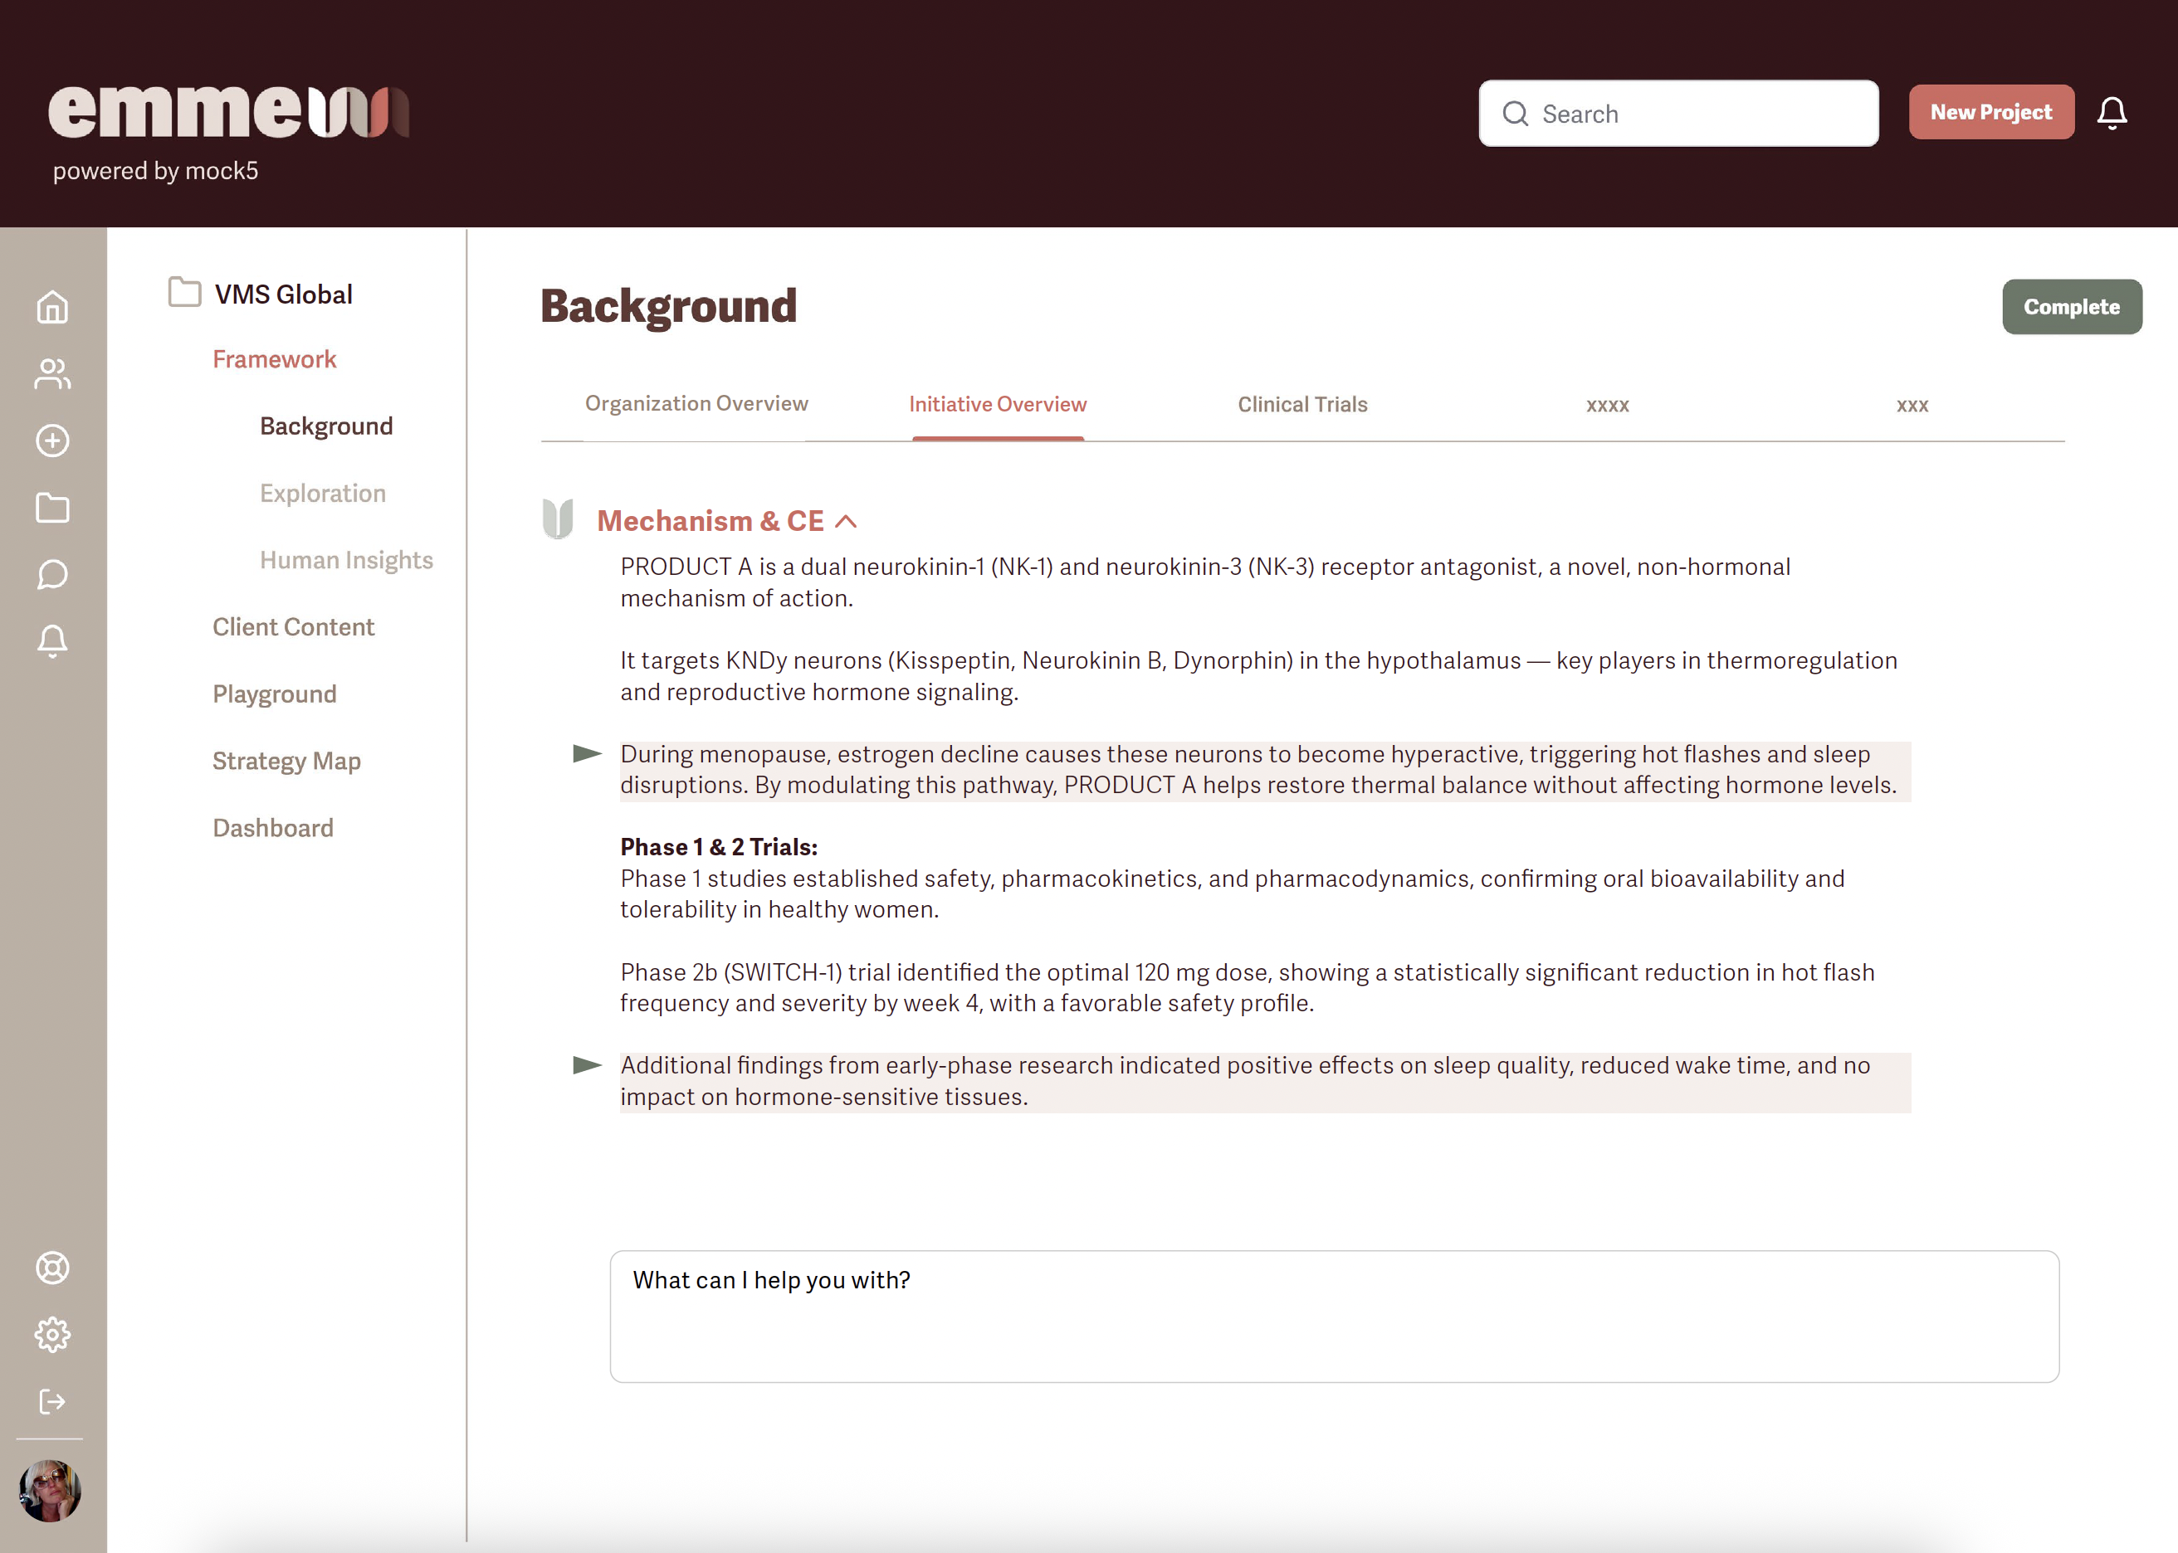

Slide 2
Product Overview (includes unmet need, MOA, efficacy, etc)
Sources
ASKED CHAT: The next step in this project would be a deep dive into Elinzanetant. I think we should start from the beginning. I guess that would be with the early clinical trials, right? Or posters? Journal articles and research?
Key Findings from the OASIS Trials:
Efficacy:
Elinzanetant demonstrated statistically significant reductions in the frequency and severity of moderate to severe VMS from baseline to weeks 4 and 12 compared to placebo. Notably, improvements were observed as early as week 1 and were sustained over the study periods.
Safety:
The long-term safety profile over 52 weeks was consistent with previous findings, confirming a favorable safety profile. No incidences of endometrial hyperplasia or malignant neoplasms were observed, and there was no signal of hepatotoxicity.
Regulatory Progress: Based on the positive outcomes from the OASIS program, Bayer submitted data to health authorities for marketing authorization of elinzanetant as a treatment for moderate to severe VMS associated with menopause. In October 2024, Bayer applied for approval with the European Medicines Agency (EMA).
Conclusion: The progression of elinzanetant through the OASIS Phase 3 trials has solidified its potential as a non-hormonal, once-daily oral treatment for moderate to severe VMS associated with menopause. The consistent efficacy and favorable safety profile observed across these studies support its promise as a novel therapeutic option for women seeking relief from menopausal symptoms.
Acumen questions
Where does the information from the OASIS Trials come from ? Is that known from the customer? Is it
Where does this information go in this screen?
What CHAT question is asked were these sources uploaded to CHAT and then asked this chat question
My thought here is that we create a Corpus or Corpora of information frm which we draw insights – these sources would be included in that.
https://www.reuters.com/business/healthcare-pharmaceuticals/bayer-submits-eu-marketing-application-menopause-relief-drug-2024-10-15/?utm_source=chatgpt.com
https://www.patientcareonline.com/view/elinzanetant-found-safe-effective-for-vms-linked-to-breast-cancer-treatment-daily-dose
https://www.bmj.com/content/382/bmj-2022-072612
https://clinicaltrials.gov/study/NCT06949553?cond=vms&term=oasis&rank=1
https://www.bayer.com/en/us/news-stories/elinzanetant-phase-3-study-for-vasomotor-symptoms

Slide 3
Product Overview
ASKED CHAT: Has there been any message testing with physicians?
Sources
As of now, Bayer has not publicly disclosed specific pricing details or reimbursement strategies for elinzanetant in the United States, United Kingdom, or European Union. However, several factors suggest how Bayer might approach market access and pricing for this non-hormonal treatment for vasomotor symptoms (VMS) associated with menopause:
Market Context and Competitive Landscape: Elinzanetant is poised to enter a market where Astellas' Veozah (fezolinetant), another non-hormonal treatment for VMS, is already available. Veozah was launched with a list price of approximately $550 per month in the U.S., which is about three times higher than the cost-effective threshold suggested by the Institute for Clinical and Economic Review (ICER). Veozah's uptake has been slower than anticipated, partly due to reimbursement challenges and competition from more affordable hormone replacement therapies.
Bayer's Strategic Considerations: Given the hurdles faced by Veozah, Bayer may consider a more competitive pricing strategy for elinzanetant to facilitate broader market access and payer acceptance. This could involve setting a price point that balances affordability with the drug's value proposition as a non-hormonal alternative for women who cannot or prefer not to use HRT.
Bayer has expressed intentions to leverage its established presence in women's health to support elinzanetant's launch. This includes engaging with healthcare professionals and payers to communicate the clinical benefits demonstrated in the OASIS trials, such as significant reductions in VMS frequency and severity, as well as improvements in sleep disturbances and quality of life.
Regulatory and Market Access Efforts: Bayer has submitted regulatory applications for elinzanetant in multiple regions, including the U.S. FDA, the UK's Medicines and Healthcare products Regulatory Agency (MHRA), and the European Medicines Agency (EMA). These submissions are based on positive outcomes from the OASIS clinical trial program.
While specific reimbursement negotiations have not been detailed publicly, Bayer's proactive regulatory submissions suggest a commitment to securing market access across key regions.
Conclusion: Although exact pricing and reimbursement details for elinzanetant remain undisclosed, Bayer's strategic positioning, awareness of market dynamics, and emphasis on the drug's clinical benefits indicate a thoughtful approach to market access. As elinzanetant progresses through regulatory reviews, further information on pricing and reimbursement strategies is expected to emerge.
https://pharmaphorum.com/news/bayer-cues-filings-rival-astellas-menopause-drug

Slide 4
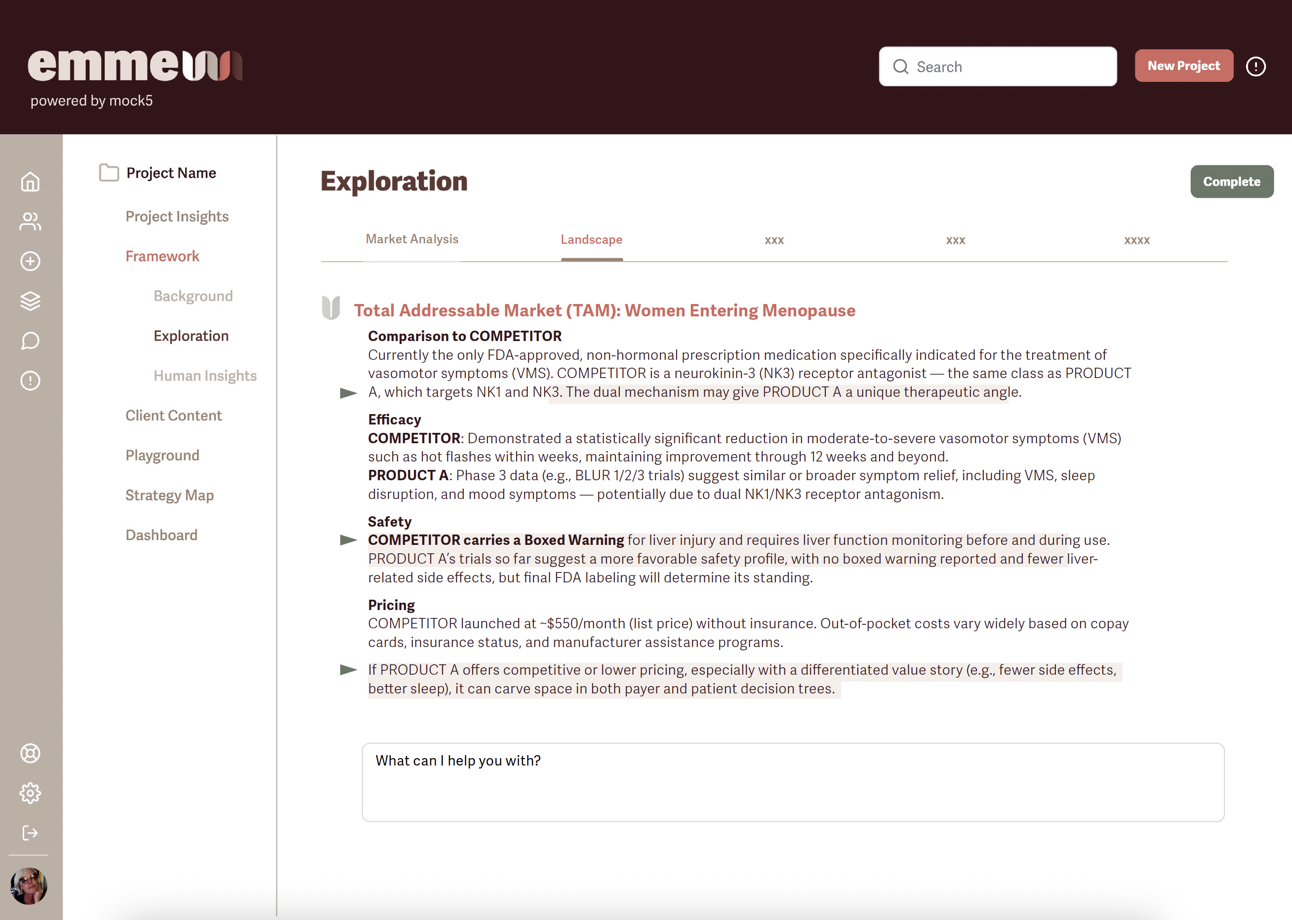

Slide 5
Product Overview
ASKED CHAT: Any information on potential pricing or reimbursement?
Sources
Production Cost Considerations for Elinzanetant
Drug Classification: Elinzanetant is a small-molecule, orally administered capsule that targets neurokinin-1 and neurokinin-3 receptors. Small-molecule drugs typically have lower production costs compared to biologics, as they do not require complex biological manufacturing processes.
Manufacturing Complexity: The synthesis of elinzanetant involves standard chemical processes, which are generally well-established in the pharmaceutical industry. This suggests that the manufacturing process may not entail unusually high costs.
Economies of Scale: As production scales up to meet market demand, per-unit manufacturing costs often decrease due to economies of scale. This could further reduce the overall production expenses for elinzanetant over time.
Implications for Pricing and Market Strategy
Pricing Strategy: While production costs are a factor in determining drug pricing, they are often outweighed by considerations such as research and development expenses, market competition, and perceived therapeutic value.Therefore, even with potentially moderate production costs, the final pricing of elinzanetant will likely reflect a combination of these factors.
Competitive Landscape: Elinzanetant is expected to compete with Astellas' Veozah (fezolinetant), which has a list price of approximately $550 per month in the U.S. market. Bayer's pricing decisions may take into account the need to position elinzanetant competitively within this landscape.
In summary, while specific production costs for elinzanetant have not been disclosed, its classification as a small-molecule oral drug suggests that manufacturing expenses may be relatively moderate. However, the final pricing will depend on a broader set of strategic considerations beyond production costs alone.
https://pharmaphorum.com/news/bayer-files-first-application-menopause-drug-elinzanetant?utm_source=chatgpt.com
https://pharmaphorum.com/news/bayer-cues-filings-rival-astellas-menopause-drug?utm_source=chatgpt.com
https://www.biopharmadive.com/news/bayer-elinzanetant-menopause-drug-results/710686/?utm_source=chatgpt.com

Slide 6
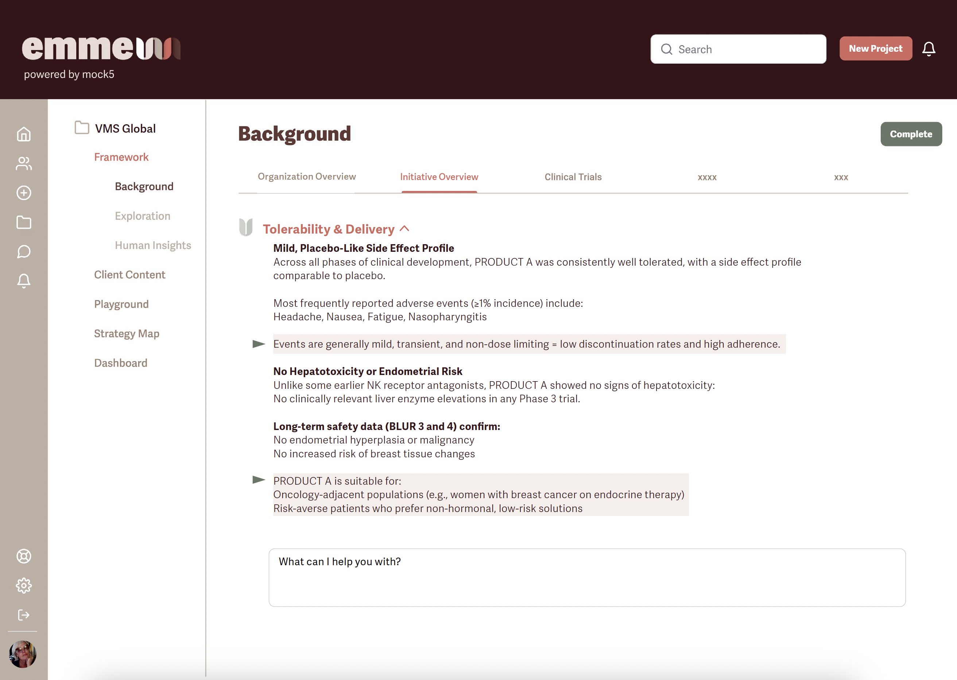

Slide 7
Product Overview
ASKED CHAT: One more thing. Storage and handling. Any details on stability or temperature concerns?
Sources
Storage and Handling Guidelines
For Research-Grade Elinzanetant (Powder Form):
Long-Term Storage:
−20°C: Stable for up to 3 years.Abmole+4MedChemExpress File+4MedChemExpress File+4
4°C: Stable for up to 2 years.MedChemExpress File
In Solution:
−80°C: Stable for up to 6 months.MedChemExpress File+3MedChemExpress File+3BioSpace+3
−20°C: Stable for up to 1 month.MedChemExpress File+3Abmole+3MedChemExpress File+3
Shipping Conditions:
Can be shipped at room temperature if transit time is less than 2 weeks.MedChemExpress File
Handling Precautions:
Store in a tightly sealed container within a cool, well-ventilated area.Abmole
Protect from direct sunlight and sources of ignition.MedChemExpress File+1Abmole+1
Note: These guidelines are based on research-grade material and may differ from commercial formulations.
Commercial Formulation Considerations
While specific storage requirements for the commercial formulation of elinzanetant have not been publicly disclosed, it's anticipated that Bayer's final product will be designed for stability under standard pharmaceutical conditions:
Expected Storage Conditions:
Likely to be stable at controlled room temperature (15–25°C or 59–77°F).
Standard precautions to protect from moisture and light.
Packaging: Anticipated to be provided in blister packs or sealed containers to ensure product integrity.US EPA
These expectations are based on typical pharmaceutical practices and the need for ease of distribution and patient compliance.
Implications for Distribution and Access
Logistics: If the commercial product is stable at room temperature, it simplifies storage and transportation logistics, making it accessible in various healthcare settings, including those with limited refrigeration capabilities.
Patient Convenience: Room temperature stability enhances patient adherence by eliminating the need for special storage conditions at home.
https://www.epa.gov/system/files/documents/2021-11/bmp-hazardous-materials-storage.pdf?utm_source=chatgpt.com
https://file.medchemexpress.com/batch_PDF/HY-109171/Elinzanetant-DataSheet-MedChemExpress.pdf?utm_source=chatgpt.com
https://www.abmole.com/literature/elinzanetant-msds.html?utm_source=chatgpt.com

Slide 8
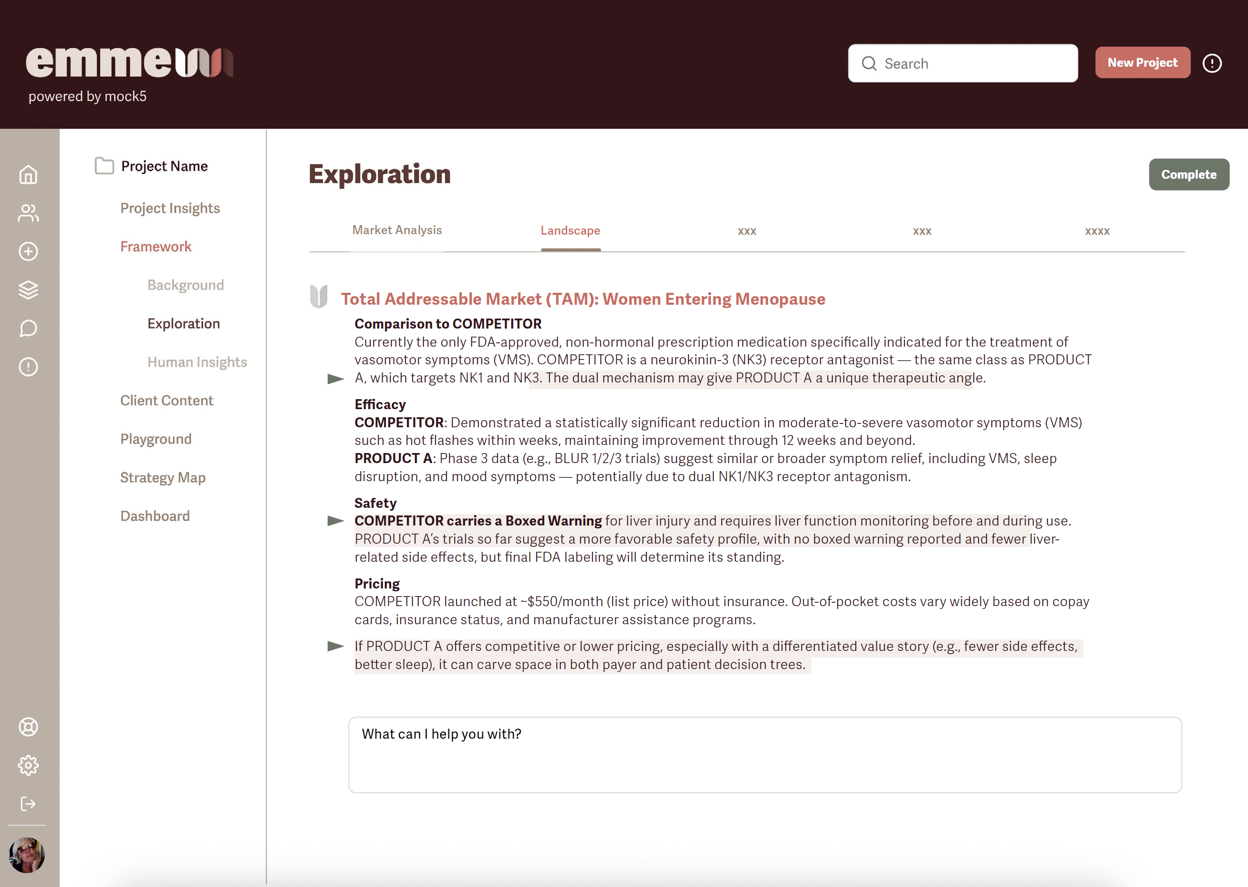

Slide 9
Competitive & Market Landscape
Sources
ASKED CHAT: can you find revenue reports on Veozah?
Veozah Revenue Overview Fiscal Year 2023 (Ended March 31, 2024):
Sales Performance: Astellas reported global sales of approximately ¥14.8 billion (~$100 million USD) for Veozah during this period
Fiscal Year 2024 (Forecast):
Sales Projection: The company has projected global sales of ¥7.1 billion (~$50 million USD) for Veozah in FY2024, citing slower-than-expected demand and challenges in market uptake
Challenges Impacting Sales Market Uptake: Despite significant marketing efforts, including a Super Bowl advertisement, Veozah's uptake has been slower than anticipate. Astellas attributes this to factors such as limited payer coverage and hesitancy among healthcare providers to prescribe the medicatio.
Revised Expectations: Initially, Astellas had projected peak annual sales for Veozah between ¥300 billion to ¥500 billion (~$2.2 billion to $3.4 billion USD). However, these expectations have been tempered in light of current market performance.
These figures reflect the current financial performance and projections for Veozah as reported by Astella. For the most detailed and up-to-date information, it's advisable to consult Astellas' official financial reports and investor communication.
https://pharmaphorum.com/news/astellas-raises-padcev-forecasts-bladder-cancer-data?utm
https://www.fiercepharma.com/pharma/astellas-sales-expectations-are-padcev-down-veozah?utm
https://www.drugpatentwatch.com/p/drug-price/drugname/VEOZAH?utm

Slide 10
Competitive & Market Landscape
ASKED CHAT: What are the 2024 projections for the UK and EU?
Sources
As of April 2025, Astellas has not publicly disclosed specific revenue projections for Veozah (marketed as Veoza in Europe) in the UK and EU markets for 2024. However, available information provides some context:
Global Sales Performance: In fiscal year 2023, Astellas reported global sales of approximately JPY 14.8 billion (~$100 million USD) for Veozah.
Launch in Europe: Veozah has been launched in several European countries, including the UK and Germany, under the brand name Veoza.
Market Uptake Challenges: Despite the European launches, Astellas has faced challenges in market uptake, citing factors such as limited payer coverage and hesitancy among healthcare providers to prescribe the medication.
Given these factors, while specific regional projections are not available, the overall performance suggests that Astellas is monitoring the European market closely and may adjust its strategies accordingly.
Over-the-counter (OTC) options for hot flashes typically focus on natural remedies, supplements, and lifestyle supports rather than pharmaceuticals. While they don’t match the efficacy of prescription hormone or neurokinin-based therapies like elinzanetant or fezolinetant, they remain widely used due to accessibility and perceived safety.
https://pharmaphorum.com/news/astellas-raises-padcev-forecasts-bladder-cancer-data?utm_source=chatgpt.com

Slide 11
Competitive & Market Landscape
ASKED CHAT: Is there any way to estimate about how much women in the US and UK spend annually treating hot flashes with these types of remedies?
Sources
Estimating the annual expenditure on over-the-counter (OTC) remedies for hot flashes in the U.S. and U.K. involves analyzing the broader menopause supplement markets, as specific data for hot flash treatments alone is limited. Here's a breakdown based on available information:
United States
Menopause Supplement Market Size: In 2024, the U.S. menopause supplement market is projected to be approximately $290 million USD, with a compound annual growth rate (CAGR) of 5.1% through 2034.
Consumer Spending Patterns: Surveys indicate that 76% of women spend less than $50 per month on menopause-related treatments, including OTC remedies and dietary supplements. This suggests an annual expenditure of up to $600 per individual.
United Kingdom
Menopause Market Size: The U.K. menopause market generated a revenue of $449.1 million USD in 2022 and is expected to reach $648.1 million USD by 2030, growing at a CAGR of 4.7%. Dietary supplements were the largest revenue-generating segment in 2022.
Consumer Spending Patterns: While specific per-person spending data is limited, the significant market size indicates substantial consumer investment in OTC menopause remedies, including those targeting hot flashes.
https://www.futuremarketinsights.com/reports/menopause-supplement-market
https://www.goodrx.com/healthcare-access/research/menopause-survey-affordability?utm
https://www.grandviewresearch.com/horizon/outlook/menopause-market/uk?utm

Slide 12
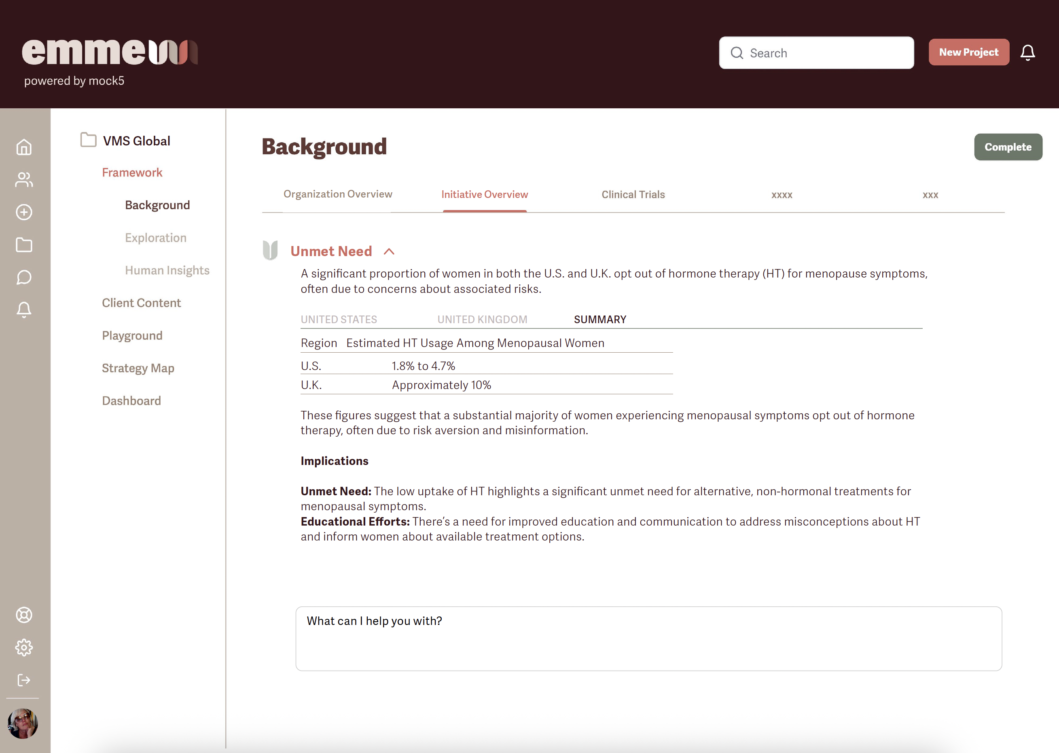

Slide 13
Competitive & Market Landscape
ASKED CHAT: based on accessible clinical trial studies, can you estimate approximately how many women in the markets we are targeting opt of treatment because of being risk-averse to hormone therapy?
Sources
United States
Decline in HT Usage: The prevalence of menopausal hormone therapy (MHT) use among postmenopausal women in the U.S. declined from 26.9% in 1999-2000 to 4.7% in 2017-2020.
Current Usage Rates: As of 2023, hormone therapy use among menopausal women has fallen to just 1.8%.
Reasons for Decline: The decline is attributed to lingering concerns stemming from the Women's Health Initiative (WHI) study published in 2002, which reported increased risks of breast cancer and cardiovascular disease associated with HT. Despite subsequent analyses clarifying these risks, many women and healthcare providers remain cautious.
United Kingdom
HT Prescription Rates: In some parts of the U.K., only around 10% of menopausal women are prescribed HT.
Public Perception: A significant number of women avoid HT due to perceived risks, despite evidence supporting its safety and efficacy for many. Misinformation and lack of awareness contribute to low uptake.
Implications:
Unmet Need: The low uptake of HT highlights a significant unmet need for alternative, non-hormonal treatments for menopausal symptoms.
Educational Efforts: There's a need for improved education and communication to address misconceptions about HT and inform women about available treatment options.
https://jamanetwork.com/journals/jama-health-forum/fullarticle/2823976?utm
https://www.healio.com/news/womens-health-ob-gyn/20240913/hormone-therapy-use-among-menopausal-women-continues-to-decline-despite-proven-safety?utm
https://www.forbes.com/sites/debgordon/2021/07/13/73-of-women-dont-treat-their-menopause-symptoms-new-survey-shows/?utm
https://bjgp.org/content/66/653/597?utm
https://academic.oup.com/fampra/article-abstract/19/6/591/477705?redirectedFrom=fulltext&login=false&utm

Slide 14
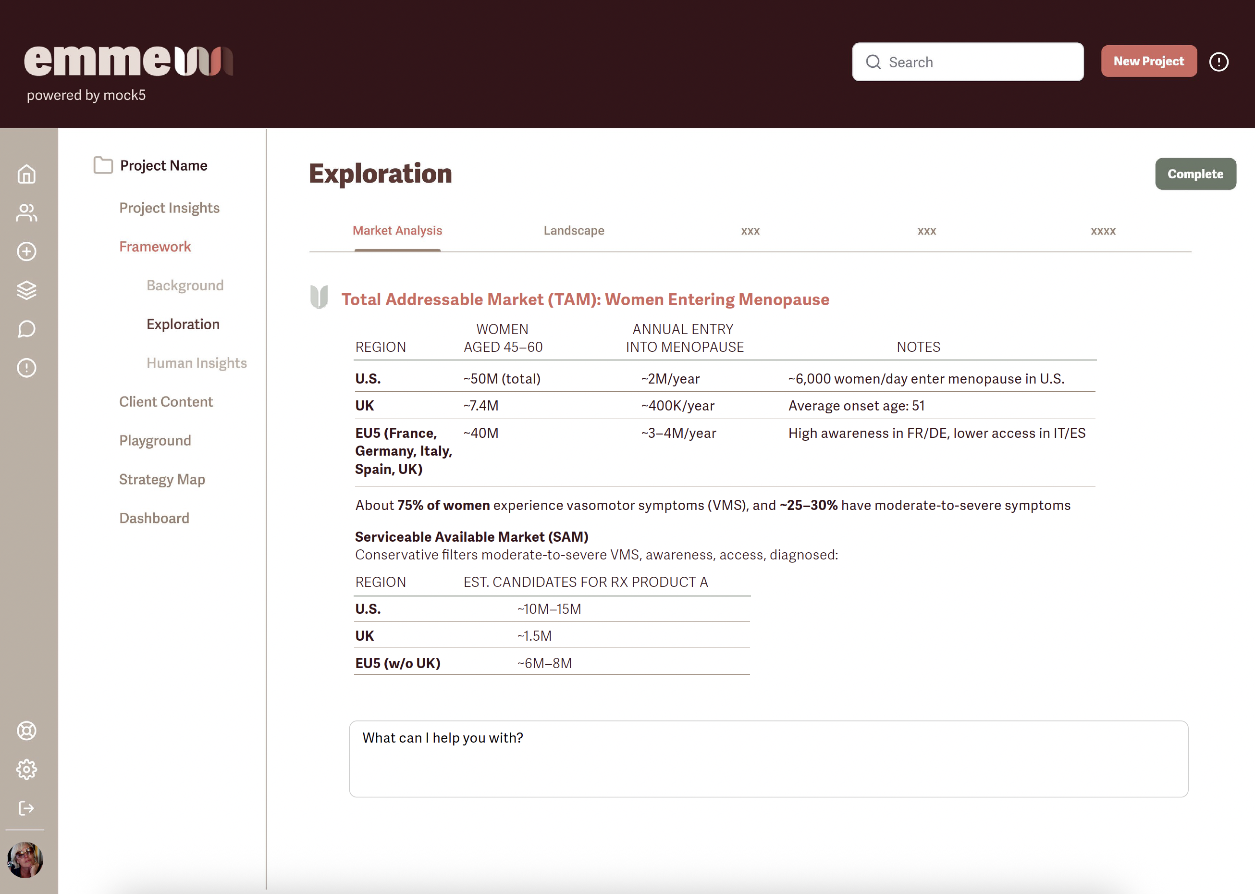

Slide 15
Patient Demographics
Sources
Core Age Range
Typical age of natural menopause onset: ~51 years old (in the U.S.)
Perimenopause: starts ~45–55
Postmenopause: from 55 onwards
Treatment-eligible population: likely 40–65 years old
Primary age range: 45–60 (actively experiencing symptoms and seeking relief)
Secondary range: 40–44 (early onset or induced menopause) and 60–65+ (still symptomatic, particularly those untreated or seeking alternatives)
Foundational Patient Segments to Explore
Risk-Averse, Non-Hormone Seekers
Avoiding or unable to take estrogen therapies due to medical history (e.g., breast cancer, clotting disorders, stroke risk)
Open to alternatives but cautious
Lifestyle-Oriented, Quality-of-Life Seekers
Disrupted sleep, work stress, relationship strain due to symptoms
Looking for something to get them back to feeling "like themselves"
Silent Strugglers
Underdiagnosed, don’t talk to HCPs, think symptoms are “just aging”
May not seek treatment unless it's easy, trusted, or recommended
Highly Proactive Health Managers
Health-literate, digitally engaged, already exploring new treatments
May be influencers in their networks
Equity Gap Patients
BIPOC communities, lower income or rural access issues
Historically excluded or mistreated in women’s health
https://www.who.int
https://www.oecd.org
https://www.nice.org.uk
https://eige.europa.eu
https://ec.europa.eu/eurostat/data/database
https://www.pewresearch.org
https://www.womens-health-concern.org

Slide 16
Patient Demographics
Sources
Cultures/Contexts Where Menopause May Be Taboo or Underdiscussed
These may vary within countries and communities, but there are consistent patterns of silence or shame around menopause, especially where:
Sexual health is stigmatized
Aging is equated with loss of femininity or value
Discussions about the body are considered immodest
Medical decisions are heavily influenced by family, religion, or gender dynamics
Contexts to Consider
South Asian Communities (India, Pakistan, Bangladesh)
Menopause often described euphemistically (“change of life”)
Conversations about sexual discomfort, mood shifts, or loss of libido are rare
Modesty norms may limit willingness to see male providers or ask direct questions
Stigma around HRT, and reluctance to “complain” or “be weak”
Patient Considerations:
Use respectful, family-affirming language
Normalize menopause as a health milestone, not a shameful end
Offer female providers, culturally sensitive spaces, and discreet options
Middle Eastern and North African Communities
Modesty and gender norms play a central role
Sexual health conversations are often off-limits, even among women
Menopause may be tied to spiritual interpretations (e.g., a time of transition and wisdom)
Medical advice may be filtered through husbands or male family members
Patient Considerations:
Frame as physical well-being, not sexual rejuvenation
Emphasize comfort, dignity, and strength
Offer written materials for private reading, peer support in female-led forums
https://www.who.int
https://www.oecd.org
https://www.nice.org.uk
https://eige.europa.eu
https://ec.europa.eu/eurostat/data/database
https://www.pewresearch.org
https://www.womens-health-concern.org

Slide 17
Patient Demographics
Sources
East Asian Cultures (China, Japan, Korea)
Cultural pressure to remain stoic and uncomplaining
Menopause may be seen as natural and not needing intervention
Strong reliance on Traditional Chinese Medicine (TCM), Kampo, or herbal solutions
Low discussion of libido or mental health symptoms
Patient Considerations:
Respect traditions while presenting gentle, science-backed options
Avoid language of “treatment” or “disorder”—consider “balance,” “support,” or “harmony”
Integrate with or acknowledge Eastern wellness approaches
Conservative Christian and Orthodox Religious Communities
Often value modesty and silence around sexuality or body changes
Women may see symptoms as part of their spiritual path or as something to “offer up”
Avoidance of pharmaceuticals or modern interventions in some cases
Patient Considerations:
Emphasize mental clarity, strength for caregiving, and whole-self wellness
Frame as non-invasive support to maintain daily function and purpose
Respect religious language around dignity, womanhood, and aging
Certain African Cultural Contexts
Menopause may be interpreted spiritually (e.g., becoming an elder, respected figure)
Shame or fear of being seen as "past usefulness" or “no longer a woman”
Limited formal health education access, but strong communal traditions
Patient Considerations:
Engage with community leaders or respected female elders
Use storytelling, shared wisdom, and oral education styles
Highlight strength, leadership, and resilience rather than symptom suppression
https://www.who.int
https://www.oecd.org
https://www.nice.org.uk
https://eige.europa.eu
https://ec.europa.eu/eurostat/data/database
https://www.pewresearch.org
https://www.womens-health-concern.org

Slide 18
Provider Demographics
Sources
REGIONAL BREAKDOWN: POTENTIAL PRESCRIBERS FOR ELINZANETANT
United States
Prescribing authority: Broad; MDs, DOs, NPs, and PAs can prescribe
Key prescriber types:
OB/GYNs: Primary specialists in menopause care; ~22,000 board-certified OB/GYNs.
Primary Care Providers (PCPs): Family Medicine and Internal Medicine physicians often manage menopause symptoms, especially in under-resourced areas.
Nurse Practitioners (NPs) and Physician Assistants (PAs): Often the first point of care in outpatient settings; may be more common in rural or community health environments.
Endocrinologists: May prescribe for complex cases, especially where hormonal balance or contraindications are involved.
Women's Health Clinics: Including integrated care models at academic centers and independent menopause clinics.
Regional variance:
West Coast & Northeast: More integrative and specialized care models, higher access to women’s health services.
Southeast & Midwest: PCPs may be more prominent in prescribing due to OB/GYN shortages.
Veterans Affairs (VA) & Community Health Centers: Tend to adopt nonhormonal therapies more readily due to contraindication profiles in diverse populations.
https://www.nice.org.uk
www.thebms.org.uk
www.ema.europa.eu
https://www.rcog.org.uk
https://jamanetwork.com

Slide 19
Provider Demographics
Sources
REGIONAL BREAKDOWN: POTENTIAL PRESCRIBERS FOR ELINZANETANT
United Kingdom
Prescribing authority: GPs, consultants, nurse prescribers.
Key prescriber types:
General Practitioners (GPs): Most common menopause symptom managers; account for ~90% of HRT prescriptions.
Gynecologists/Consultants in Menopause Clinics: Handle more complex cases or where HRT is contraindicated.
Specialist Nurses: Prescribing rights for menopause treatments with proper training; increasing presence in NHS menopause pathways.
Regional variance:
England & Scotland: NHS menopause hubs and clinics vary by Trust, with some providing easier access to specialist prescribers.
Private Sector Clinics: Growing significantly; high uptake of new menopause therapies due to shorter approval lag and more engaged patients.
https://www.nice.org.uk
www.thebms.org.uk
www.ema.europa.eu
https://www.rcog.org.uk
https://jamanetwork.com

Slide 20
Provider Demographics
Sources
REGIONAL BREAKDOWN: POTENTIAL PRESCRIBERS FOR ELINZANETANT
European Union
Prescribing authority: Varies by country, but GPs, OB/GYNs, and specialists commonly involved.
Key prescriber types (common across major markets like Germany, France, Netherlands):
General Practitioners: Often initial contact, especially in countries with strong primary care systems.
Gynecologists: Dominant in countries like Germany, Italy, and Spain, where direct specialist access is common.
Endocrinologists: Less involved than in U.S., but relevant in complex hormone-related cases.
Pharmacists (limited role): In some countries, like France and Spain, can suggest menopause-related supplements but not prescribe.
Regional variance:
Germany: Strong outpatient gynecology system; higher comfort with menopause care.
France: Historically conservative with hormone therapy but openness to new nonhormonal options is growing.
Nordics & Netherlands: Progressive approaches to women's health and menopause; early adopters likely.
Eastern Europe: May face access challenges or slower adoption due to cost and policy.
https://www.nice.org.uk
www.thebms.org.uk
www.ema.europa.eu
https://www.rcog.org.uk
https://jamanetwork.com

Slide 21
Provider Demographics
Sources
https://www.nice.org.uk
www.thebms.org.uk
www.ema.europa.eu
https://www.rcog.org.uk
https://jamanetwork.com
Specialty | US | UK | EU | Likelihood to Prescribe
OB/GYNs | ✅ High | ✅ Moderate (Consultants) | ✅ High (esp. DE, IT, ES) | ⭐⭐⭐⭐
General Practitioners | ✅ High | ✅ Very High | ✅ Very High | ⭐⭐⭐⭐
Nurse Practitioners / PAs | ✅ Moderate to High | ✅ Moderate (Prescribing Nurses) | 🚫/✅ Limited depending on country | ⭐⭐ to ⭐⭐⭐
Endocrinologists | ✅ Niche | 🚫 Rare | ✅ Rare | ⭐⭐
Menopause Specialists | ✅ Growing | ✅ NHS & Private | ✅ Patchy access | ⭐⭐⭐⭐

Slide 22
Provider Demographics
Sources
https://www.nice.org.uk
www.thebms.org.uk
www.ema.europa.eu
https://www.rcog.org.uk
https://jamanetwork.com
Persona | Setting | Likelihood to Prescribe | Trigger Needs
Menopause Champion | Specialist clinics, private practices | ⭐⭐⭐⭐⭐ | Awareness, patient outcomes, advocacy tools
Evidence-Aligned GP | NHS practices, PCNs | ⭐⭐⭐⭐ | Clinical data, formulary inclusion, guidance
Menopause Minimalist | Traditional GP surgeries | ⭐ | Social proof, reframing of symptom burden
Prescribing Practice Nurse | GP surgeries, sexual health | ⭐⭐–⭐⭐⭐ | Training, protocol access, role clarity
Health Equity Practitioner | Community-focused services | ⭐⭐⭐ | Messaging around cultural sensitivity, ease of use
UK-Specific Considerations
Formulary inclusion (FP10) and NICE guidelines are critical for GP adoption.
BMS certification among GPs and nurses is growing—prime audience for early adoption.
There’s increasing patient pressure on the NHS to treat menopause more seriously—especially from media figures and employers offering private menopause support.
Cost transparency and equitable access will be essential for broad uptake.

Slide 23
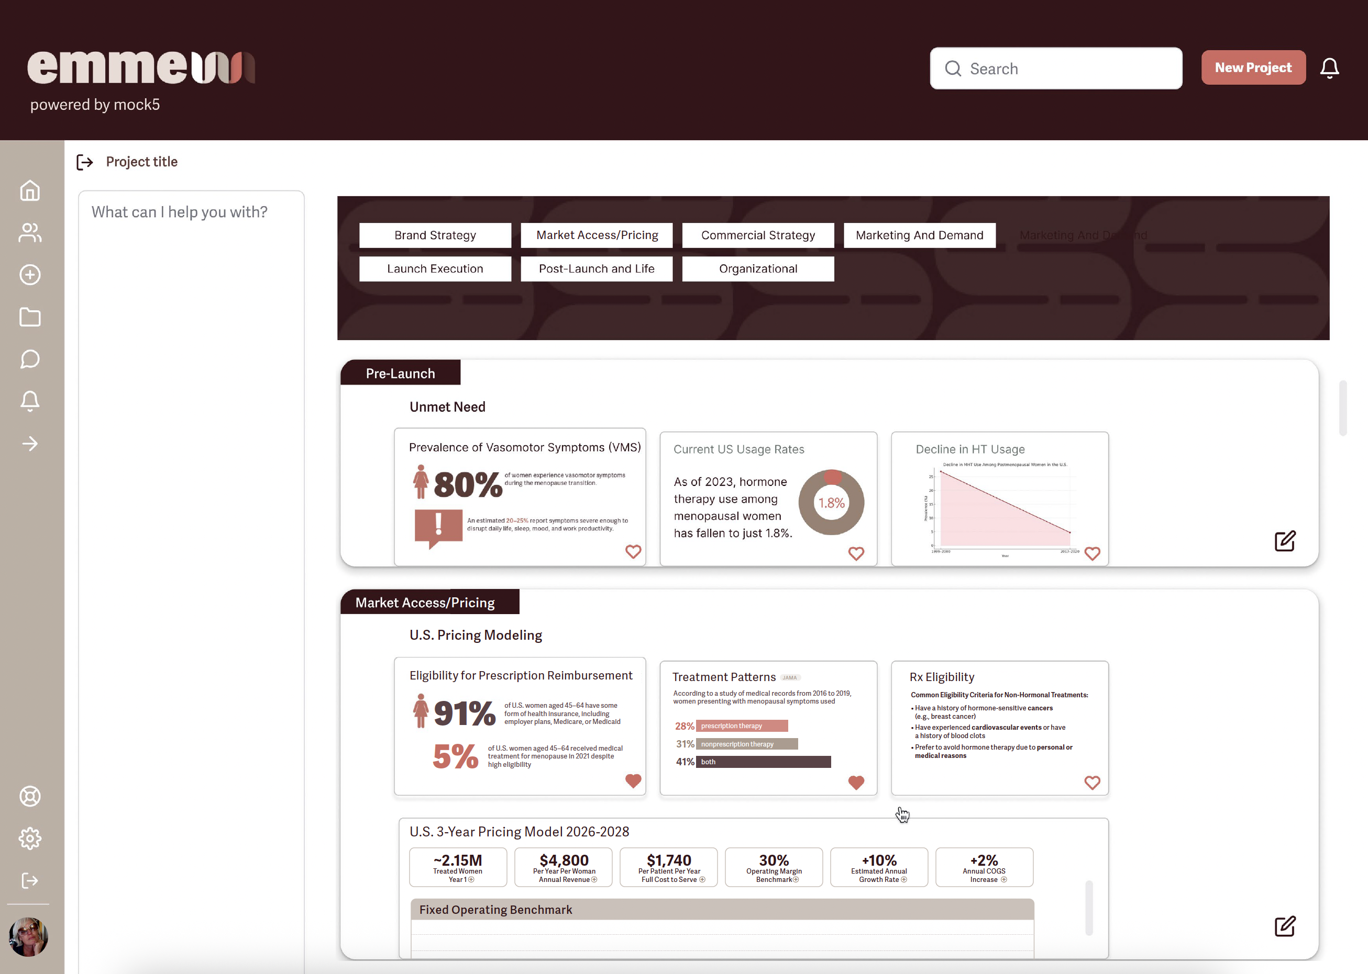

Slide 24
Go To Market Modeling / Playground
Sources
Pre-Launch Phase
1. Market and Opportunity Assessment
Epidemiological analysis: prevalence, incidence, disease burden.
Unmet need analysis: current standard of care, treatment gaps.
Market sizing and segmentation: potential patient population, geography, therapeutic line.
Competitive landscape: current and pipeline products, patents, exclusivity status.
Health economic impact: cost-effectiveness models, budget impact analysis.
2. Target Product Profile (TPP) Development
Define optimal product attributes: efficacy, safety, dosing, route of administration.
Align with regulatory strategy and future labeling.
Benchmark against competitors' TPPs.
3. Regulatory Planning
Pre-IND meetings and FDA/EMA consultations.
Fast track or orphan drug designation applications (if applicable).
Global regulatory strategy: U.S., EU5, Japan, China, etc.
4. Clinical Development Strategy
Phase I-III trial designs to support regulatory approval and market access.
Real-world evidence (RWE) and Phase IV planning.
KOL and investigator engagement.
https://www.mckinsey.com
https://www.pm360online.com
https://www.pharmexec.com
https://www.kff.org
https://www.nice.org.uk
https://www.who.int

Slide 25
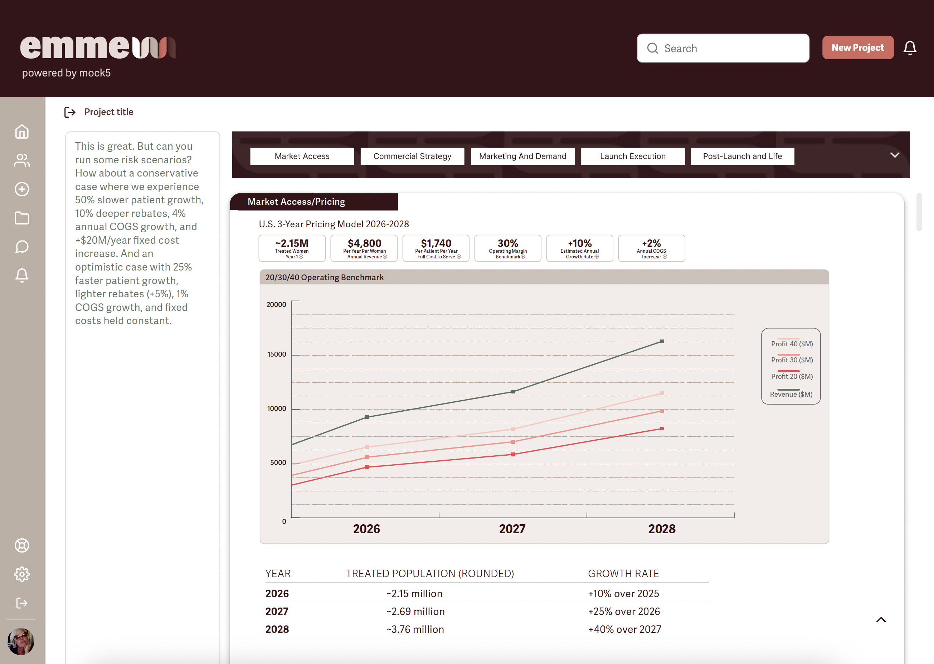

Slide 26
Go To Market Modeling / Playground
Sources
Brand Strategy and Positioning
1. Brand Platform Development
Product name development (brand and generic).
Brand identity and messaging pillars.
Differentiation narrative and value proposition.
Visual and verbal brand systems.
2. Scientific Communications and Education
Publication strategy and congress planning.
Advisory boards and steering committees.
Medical affairs planning and field medical deployment.
3. Advocacy and Stakeholder Mapping
Patient advocacy group partnerships.
Provider and HCP advisory roles.
Policy and public health engagement.
Market Access and Pricing Strategy
1. Value and Evidence Generation
Health economics and outcomes research (HEOR).
Real-world data to support reimbursement.
Value dossier and AMCP compendium creation.
2. Pricing and Reimbursement Strategy
Reference pricing benchmarks.
Tiered global pricing models.
HTA (Health Technology Assessment) submissions and payer negotiations.
3. Distribution and Channel Strategy
Specialty vs. retail pharmacy decisions.
3PL and supply chain partner selection.
Buy-and-bill vs. reimbursement hub model.
https://www.mckinsey.com
https://www.pm360online.com
https://www.pharmexec.com
https://www.kff.org
https://www.nice.org.uk
https://www.who.int

Slide 27
Go To Market Modeling / Playground
Sources
Commercial Strategy and Field Readiness
1. Sales Force Strategy
Sales model design: primary care vs. specialty; contract vs. in-house.
Targeting and segmentation: HCPs, IDNs, ACOs, academic centers.
Sales force sizing, territory alignment, training and certification.
2. Customer Engagement Planning
Omnichannel strategies: in-person, email, digital detailing.
Rep-triggered content vs. self-service HCP portals.
CRM deployment and enablement.
3. Field Medical and Access Teams
MSL deployment strategy.
Account manager and payer liaison planning.
Pull-through strategy and co-pay assistance.
Marketing and Demand Generation
1. HCP Marketing
Disease state awareness campaigns.
MOA (mechanism of action) education.
Journal ads, med ed, webinars, and direct mail.
2. DTC / DTP (Direct to Consumer / Patient) Marketing
Patient awareness and activation campaigns.
Search, social, content strategy.
Patient support programs, starter kits, nurse navigators.
3. Peer-to-Peer and KOL Activation
Speaker bureau programs.
Advisory boards and roundtables.
Regional symposiums and conference presence.
https://www.mckinsey.com
https://www.pm360online.com
https://www.pharmexec.com
https://www.kff.org
https://www.nice.org.uk
https://www.who.int

Slide 28
Go To Market Modeling / Playground
Sources
Launch Execution
1. Launch Readiness and Operations
Launch excellence frameworks (e.g., McKinsey’s “Launch Readiness Index”).
War rooms and KPI dashboards.
Cross-functional launch teams (medical, commercial, regulatory, supply).
2. Supply Chain and Distribution Readiness
Inventory management.
Cold chain / specialty requirements.
Pharmacovigilance systems and reporting.
3. Regulatory and Legal Compliance
Promotional material review processes (MLR committees).
Sunshine Act, FDA OPDP requirements.
Labeling, packaging, and risk evaluation and mitigation strategy (REMS).
Post-Launch and Lifecycle Management
1. Performance Tracking and Analytics
Launch KPIs: NRx/TRx, market share, brand awareness.
Sales force effectiveness and engagement analytics.
Digital metrics (web, social, CRM).
2. Label Expansion and LCM Strategy
New indications or lines of therapy.
Geographic expansion planning.
Formulation changes (e.g., oral to injectable).
3. Competitive Defense and Brand Evolution
Patent and exclusivity protection strategy.
Response to biosimilars or generics.
Rebranding or repositioning if necessary.
https://www.mckinsey.com
https://www.pm360online.com
https://www.pharmexec.com
https://www.kff.org
https://www.nice.org.uk
https://www.who.int

Slide 29
Go To Market Modeling / Playground
Sources
Metric | Value (Example) | Notes
Women aged 40–64 | ~64M (U.S.) | Primary target cohort
Annual entering menopause | ~1.3M | New onset population
Vasomotor symptoms prevalence | ~75% | 25% experience severe symptoms
Duration of symptoms | Avg. 7.4 years | Underscores chronicity
https://www.mckinsey.com
https://www.pm360online.com
https://www.pharmexec.com
https://www.kff.org
https://www.nice.org.uk
https://www.who.int
Therapy | Use Rate | Limitations
HRT (estrogen-based) | ~20% eligible women | Safety concerns (cancer, clot risk)
Off-label (SSRIs, gabapentin) | Growing | Not designed for menopause; limited relief
Lifestyle interventions | Common | Low efficacy in severe VMS
Segment | Size | Target Potential
Women experiencing VMS | ~45M | Primary target
Avoiding HRT | ~70% of VMS group | Elinzanetant sweet spot
Previously failed other therapies | ~30% | Secondary target

Slide 30
Go To Market Modeling / Playground
Sources
Brand | MOA | Status | Differentiation
Fezolinetant (Astellas) | NK3R antagonist | Approved (2023) | First-to-market
MLE4901 (Millendo) | NK3R antagonist | Discontinued | Liver safety issues
HRT | Estrogen-based | Longstanding | Not suitable for many
SSRI/SNRI | Neurotransmitter-based | Off-label | Efficacy varies
https://www.mckinsey.com
https://www.pm360online.com
https://www.pharmexec.com
https://www.kff.org
https://www.nice.org.uk
https://www.who.int
Factor | Impact
Reduced work absenteeism | Higher QoL, economic productivity
Fewer ER visits for unmanaged VMS | Lower burden on healthcare
Non-hormonal = reduced long-term adverse event cost | Payer-aligned positioning
Oral dosing = better adherence | Sustained outcomes
Optional Enhancements:
Timeline with milestones: key regulatory dates, data readouts, expected launch
Stakeholder map: patients, OB/GYNs, payers, employers
Insights from real-world studies (if available)

Slide 31
Go To Market Modeling / Playground / Pricing Modeling
Sources
Overview: Pricing Model Framework
Value-Based Pricing: Based on the perceived value to the customer (common in health and wellness, pharma, and innovation markets).
Cost-Plus Pricing: Costs plus a margin — useful if you have clear manufacturing, marketing, or service delivery costs.
Competitive Pricing: Benchmarking competitors' pricing in each region and adjusting slightly based on your differentiation.
Tiered or Subscription Pricing: Different levels based on access, volume, or service features.
Regional Modifiers: Reflect local purchasing power, healthcare system models (private vs nationalized), and regulatory costs.
Regional Market Factors to Consider
United States:
Out-of-pocket costs are higher; insurance coverage complexity.
Higher WTP (willingness to pay) for convenience, innovation, or outcomes.
Private sector dominance in healthcare/pharma.
United Kingdom:
NHS pricing pressure — focus on cost-effectiveness and NICE approval if in healthcare.
Tight public sector budgets; limited out-of-pocket purchase willingness.
Focus on "health economics" arguments.
European Union (focus markets: Germany, France, Spain, Italy):
Public and private blend depending on country.
Highly regulated; reimbursement often requires health technology assessments (HTA).
Value-for-money expectations; often conservative uptake unless clear superiority.
https://www.who.int/teams/health-product-and-policy-standards/medicines-selection-ip-and-affordability/affordability-pricing
https://www.oecd.org
https://www.globaldata.com
https://ppri.goeg.at
https://www.nice.org.uk
https://www.has-sante.fr
https://www.g-ba.de/english/
https://www.ispor.org

Slide 32
Go To Market Modeling / Playground / Pricing Modeling
Sources
Drafting Core Models
https://www.who.int/teams/health-product-and-policy-standards/medicines-selection-ip-and-affordability/affordability-pricing
https://www.oecd.org
https://www.globaldata.com
https://ppri.goeg.at
https://www.nice.org.uk
https://www.has-sante.fr
https://www.g-ba.de/english/
https://www.ispor.org
Model | U.S. | U.K. | E.U.
Model 1: Premium Value-Based | Higher price for innovation/ convenience. Market to early adopters and private insurers. | Limited use; apply for specific private sector sales. | Focus on private clinics, direct-to-patient services.
Model 2: Access-Focused | Moderate price, easier reimbursement, cost-share programs. | Affordable public sector-friendly pricing. | Public-private blended model; tender pricing for public, higher for private.
Model 3: Tiered Subscription / Service Model | SaaS-style tiers (basic, advanced, premium). | Possible only for private sector/NHS partnerships. | Regional flexibility: allow subscription or pay-per-use where viable.
Next Steps
Step 1: Confirm the core value propositions in each region (what problem you're solving and how it is perceived locally).
Step 2: Identify and gather real-world price comparators for each market (similar solutions, therapeutic comparators, or adjacent industries).
Step 3: Estimate base costs + profit margin goals.
Step 4: Adjust for regional modifiers (currency, tax, regulatory costs, reimbursement complexity).
Step 5: Build sample projections (Volume x Price = Revenue) under low, medium, and high adoption scenarios.

Slide 33
Go To Market Modeling / Playground / Pricing Modeling
Sources
Visualizing the Pricing
If you want, I can also help you build a pricing comparison table and graph sample revenue curves to visualize:
Price sensitivity curves
Expected adoption curves
Break-even points
Profit margins across regions
Key Context: U.S. Menopause Market Insights
OTC Menopause Market: ~$290M/year
Average Spend Per Woman: ~$600/year
Rx Competition Example: Veozah projects ~$50M in U.S. sales in 2024 (down ~50% from 2023)
Key Issue for Veozah: Insufficient payer coverage, which depressed uptake
Unique Bayer Opportunity with Elinzanetant: Affordable production cost
Ability to create high-volume adoption through smart pricing
Can play in both OTC-adjacent (cash pay) and reimbursed channels if positioned strategically
https://www.who.int/teams/health-product-and-policy-standards/medicines-selection-ip-and-affordability/affordability-pricing
https://www.oecd.org
https://www.globaldata.com
https://ppri.goeg.at
https://www.nice.org.uk
https://www.has-sante.fr
https://www.g-ba.de/english/
https://www.ispor.org

Slide 34
Go To Market Modeling / Playground / Pricing Modeling
Sources
Modeling Pricing in the U.S.
In the U.S., a significant portion of women experiencing menopausal symptoms are eligible for prescription reimbursement through various insurance plans. However, actual utilization of prescription treatments remains low due to factors such as limited awareness, provider hesitancy, and payer restrictions.
Eligibility for Prescription Reimbursement
Insurance Coverage: Approximately 91% of U.S. women aged 45–64 have some form of health insurance, including employer-sponsored plans, Medicare, or Medicaid. This widespread coverage suggests that a large percentage are eligible for prescription reimbursement, including for menopause-related treatments.
Utilization Rates: Despite high eligibility, only about 5% of women aged 45–64 received medical treatment for menopause in 2021. This indicates a significant gap between eligibility and actual treatment utilization.
Common Eligibility Criteria for Non-Hormonal Treatments
Non-hormonal therapies are often considered for women who:
•Have a history of hormone-sensitive cancers (e.g., breast cancer)
Have experienced cardiovascular events or have a history of blood clots
Prefer to avoid hormone therapy due to personal or medical reasons
These criteria expand the potential candidate pool beyond oncology patients.
https://www.aarp.org
https://mcpress.mayoclinic.org
https://www.health.com
https://www.rtihs.org
https://jamanetwork.com

Slide 35
Go To Market Modeling / Playground / Pricing Modeling
Sources
Modeling Pricing in the U.S.
Historical Data on Non-Hormonal Treatment Utilization
Treatment Patterns: A study analyzing medical records from 2016 to 2019 found that among women presenting with menopausal symptoms, 28% initiated prescription medication only, 31% used nonprescription therapy only, and 41% used both.
Barriers to Access: Factors such as limited provider education on menopause management and socioeconomic disparities contribute to underutilization of available treatments.
Strategic Considerations for Market Access
Education and Awareness: Enhancing provider education and patient awareness about non-hormonal treatment options can bridge the gap between eligibility and utilization.
Insurance Navigation: Developing patient assistance programs and working with payers to improve coverage for non-hormonal treatments can facilitate access.
Targeted Outreach: Focusing on populations with higher unmet needs, such as women with contraindications to hormone therapy, can optimize market penetration.
Pharma Profit Margin Benchmarks
1. Gross Margin (Revenue – Cost of Goods Sold)
Typical Range: 70%–90%
Reflects how much is left after production, packaging, and distribution costs.
Lower for generics or complex injectables; higher for oral branded drugs.
For Elinzanetant (oral, small-molecule, branded, affordable production):
85%–90% gross margin is a fair estimate.
https://www.aarp.org
https://mcpress.mayoclinic.org
https://www.health.com
https://www.rtihs.org
https://jamanetwork.com

Slide 36
Go To Market Modeling / Playground / Pricing Modeling
Sources
Modeling Pricing in the U.S.
Operating Profit Margin
This includes R&D, marketing, admin, and overhead.
Branded Rx pharma average: 25%–35%
Generic manufacturers: 10%–20%
Big Pharma top-tier (e.g., Pfizer, Roche): 30%–40% (but with R&D risk baked in)
For a late-stage asset like Elinzanetant (with R&D largely sunk), and assuming a commercial campaign-focused model: Operating margin of ~30% is a strong, defensible benchmark.
Model Assumptions
Projected Growth Rate (2026–2028)
Assumed Growth Rates:
2026: +10% over current treated population
2027: +25% over 2026
2028: +40% over 2027
Revenue
Based on your chosen price: $400/month or $4,800/year per woman (80% of $500).
Annual Revenue = Treated Population × $4,800
Unit cost per patient (COGS) at ~$300/year.
Add operating overhead (marketing, support, sales, admin) as a fixed percentage of revenue, e.g.:
30% of revenue = $1,440/patient/year
New total cost = $300 + $1,440 = $1,740/patient/year
Net revenue (i.e., profit) = $4,800 – $1,740 = $3,060
Margin = 63.75%
https://www.aarp.org
https://mcpress.mayoclinic.org
https://www.health.com
https://www.rtihs.org
https://jamanetwork.com

Slide 37
Go To Market Modeling / Playground / Pricing Modeling
Sources
Year | Treated Population (rounded) | Growth Rate
2026 | ~2.15 million | +10% over 2025
2027 | ~2.69 million | +25% over 2026
2028 | ~3.76 million | +40% over 2027
https://www.aarp.org
https://mcpress.mayoclinic.org
https://www.health.com
https://www.rtihs.org
https://jamanetwork.com
Modeling Pricing in the U.S.
Add adjusted model that includes a 2% annual increase in cost of goods sold (COGS) to account for inflation, supply chain pressure, or incremental quality costs
Model scenarios showing profit margins over 2026–2028 after incorporating a realistic payer reimbursement mix:
Private Insurance (50%) pays 85% of list price
Medicare/Medicaid (30%) pays 65% of list price
Cash Pay (20%) pays 100% of list price
Key Risk Dimensions to Model
Here are four relevant dimensions we can use for scenario modeling:
Adoption Risk: Slower-than-expected growth in treated population
Reimbursement Risk: More aggressive payer rebates (lower net prices)
Cost Escalation: Higher-than-expected rise in COGS
Fixed Cost Inflation: Campaign or infrastructure costs increase faster than planned

Slide 38
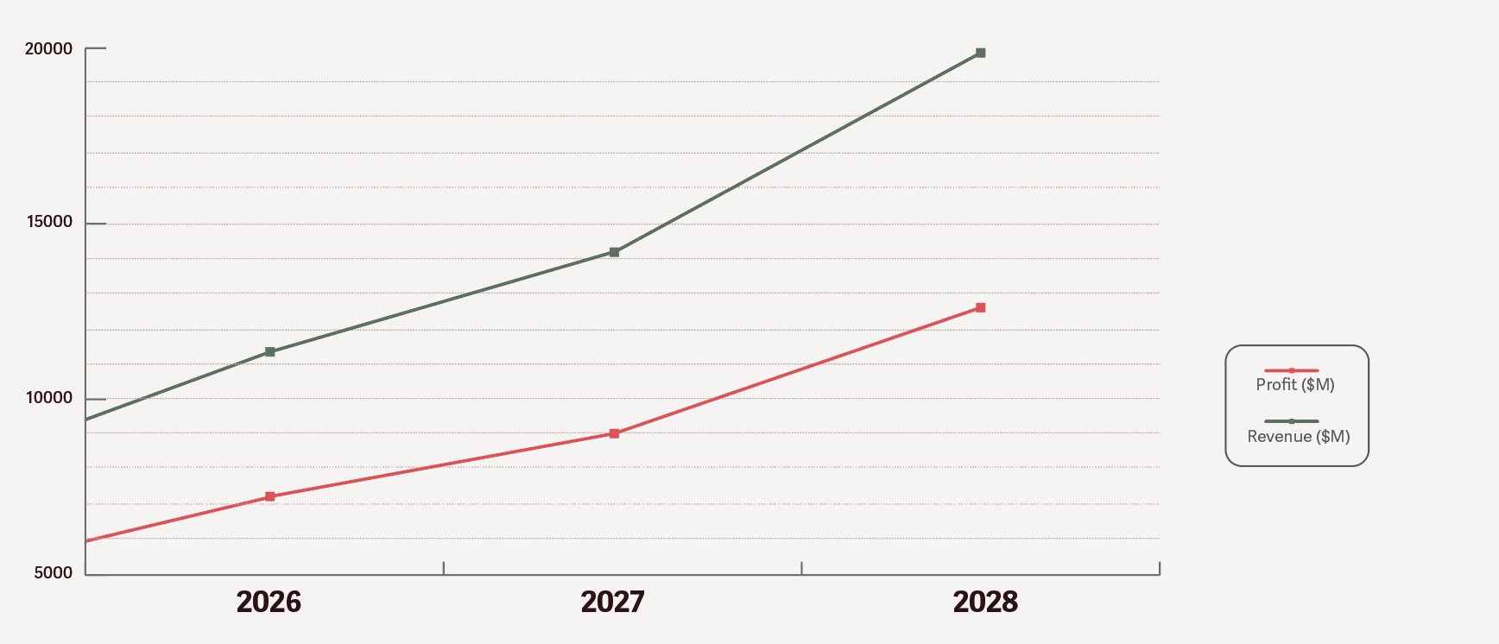
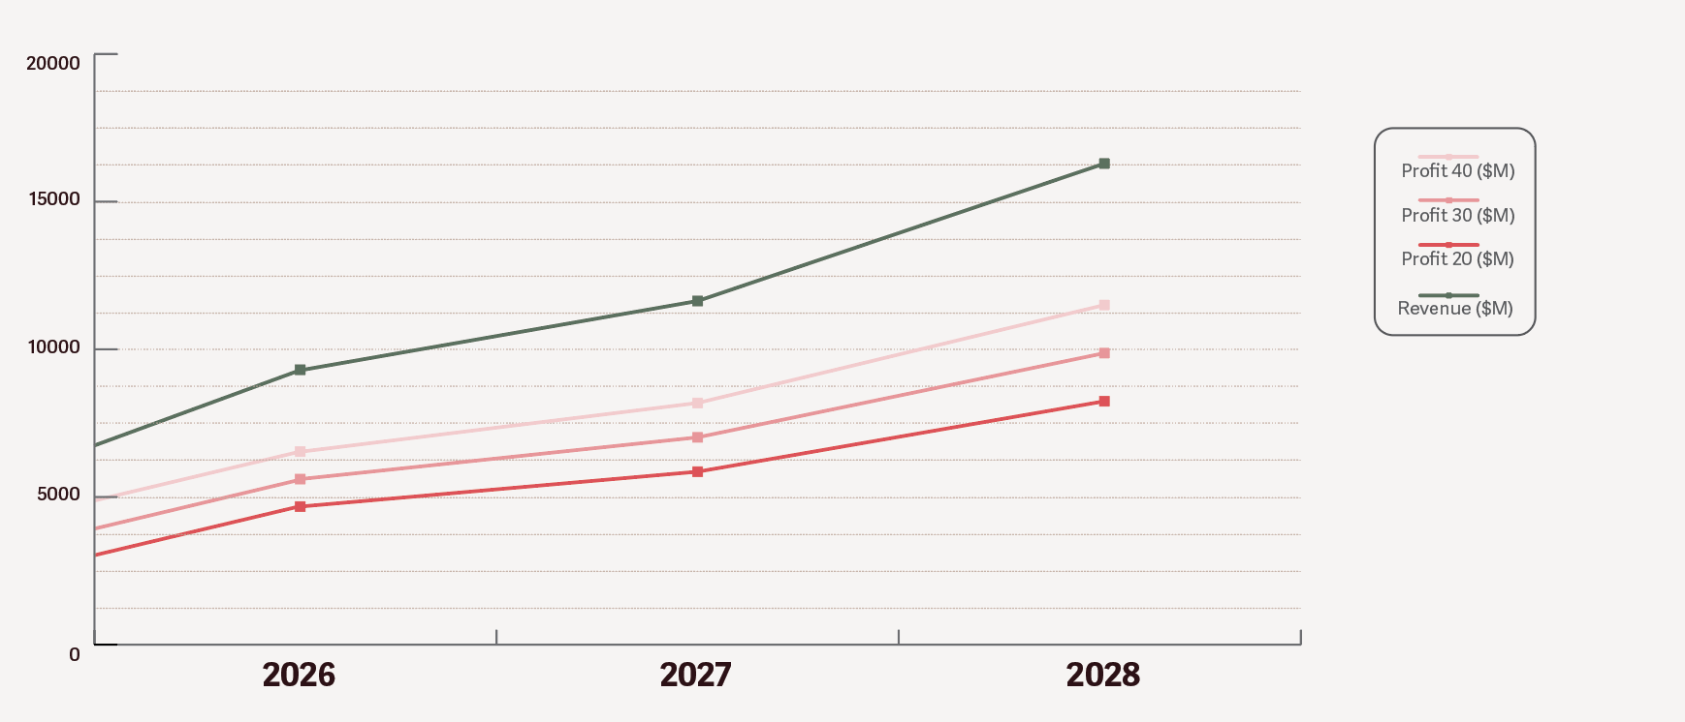
Go To Market Modeling / Playground / Pricing Modeling
Sources
Modeling Pricing in the U.S.
Planned risk scenarios
https://www.aarp.org
https://mcpress.mayoclinic.org
https://www.health.com
https://www.rtihs.org
https://jamanetwork.com
Case | Description
Base Case | As currently modeled (moderate growth, normal rebates, 2% COGS growth, steady fixed costs)
Conservative Case | 50% slower patient growth, 10% deeper rebates, 4% annual COGS growth, +$20M/year fixed cost increase
Optimistic Case | 25% faster patient growth, lighter rebates (+5%), 1% COGS growth, fixed costs held constant

Slide 39
Strategic Action Plan (derived from work in GTM model in Playground)
Sources
Closing the Gap in Menopause Treatment Utilization
Situation Overview
High Insurance Coverage, Low Utilization: While 91% of U.S. women aged 45–64 have health insurance, only ~5% receive treatment for menopause symptoms — revealing a major gap between access and action.
Treatment Landscape Insights: Non-hormonal therapies are particularly valuable for patients with contraindications to HRT, yet remain underutilized despite a broader eligible population.
Key Barriers Identified:
Low awareness (patients and providers)
Provider hesitancy or lack of training
Insurance and reimbursement complexity
Disparities tied to race, income, and geography
Strategic Goals
Increase awareness and confidence in non-hormonal options among both patients and providers.
Improve insurance navigation and address policy-related hurdles to access.
Reach underserved and high-need populations with tailored education and support.
Shift narratives around menopause to reduce stigma and drive proactive care.
Strategic Action Plan is generated from content pooled in playground, informed by account team, created by emme. This content will be used for client dashboard.

Slide 40
Strategic Action Plan (derived from work in GTM model in Playground)
Sources
Closing the Gap in Menopause Treatment Utilization
Core Pillars and Actions
1. Provider & Health System Engagement
Educational CME Content: Develop modules or workshops for OB-GYNs, PCPs, and nurse practitioners on non-hormonal therapies, safety profiles, and candidate selection.
Clinical Decision Tools: Create EHR-integrated prompts or printable checklists to guide menopause care pathways (e.g., when HRT is contraindicated).
Health System Pilot: Partner with IDNs or value-based care groups to pilot menopause care programs with focused non-hormonal treatment adoption.
2. Payer & Policy Strategy
Coverage Mapping & Advocacy: Map insurer formularies and prior auth requirements for non-hormonal treatments. Engage payers with data on untreated symptom impact (e.g., work productivity, mental health, chronic disease costs).
Patient Assistance Programs (PAPs): Co-design financial support mechanisms and transparent reimbursement pathways.
Coalition Building: Align with women’s health advocacy groups to lobby for inclusion of non-hormonal options in standard formularies and quality metrics.
Strategic Action Plan is generated from content pooled in playground, informed by account team, created by emme. This content will be used for client dashboard.

Slide 41
Strategic Action Plan (derived from work in GTM model in Playground)
Sources
Closing the Gap in Menopause Treatment Utilization
3. Patient & Community Education
Targeted Messaging Campaigns: Launch campaigns segmented by patient motivation and barriers — e.g., cancer survivors, working professionals, rural women, BIPOC communities.
Community Health Partnerships: Equip FQHCs and women’s health nonprofits with toolkits and navigator support for menopause care conversations.
Symptom Self-Assessment Tools: Create an online screening flow (HIPAA-compliant) that empowers women to understand treatment options based on personal history.
4. Equity and Inclusion
SDOH Analysis: Use heat maps and demographic overlays to identify menopause treatment deserts. Layer in pharmacy access, PCP density, income, and race data.
BIPOC Storytelling Initiatives: Gather and share lived experiences of menopause across cultural lines to reduce stigma and highlight access barriers.
Language and Literacy Adaptation: Translate materials into multiple languages and adjust for health literacy levels to ensure broader accessibility.
Strategic Action Plan is generated from content pooled in playground, informed by account team, created by emme. This content will be used for client dashboard.

Slide 42
Strategic Action Plan (derived from work in GTM model in Playground)
Sources
Metric | Baseline | Target | Timeline
% Increase in provider confidence to prescribe non-hormonal Rx | TBD | +30% | 12 months
% Increase in patient awareness of non-hormonal options | 20% (est.) | 50% | 18 months
# of payers with favorable coverage changes | 0 | 5+ | 24 months
% Uptake in non-hormonal Rx in targeted regions | TBD | +15% | 12–18 months
# of patients reached via community programs | 0 | 100K | 12 months
Strategic Action Plan is generated from content pooled in playground, informed by account team, created by emme. This content will be used for client dashboard.
Partnerships and Collaboration Opportunities
Medical Associations: ACOG, NAMS, AMA
Advocacy Groups: Black Women’s Health Imperative, Let’s Talk Menopause, Menopause Society
Payer Organizations: AHIP, Medicaid MCOs
Employers and Unions: For workplace wellness programs
Pharmacy Benefit Managers (PBMs): To influence coverage tiering and ease access

Slide 43
Strategic Action Plan (derived from work in GTM model in Playground)
Sources
Influencer and Thought Leader Activation
Why It Matters
Bridges the Trust Gap: Many women rely on social media and podcast voices to make decisions about their health, especially when clinical care feels dismissive or limited.
Normalizes Menopause Conversations: Influencers can destigmatize symptoms and advocate for treatment options, including non-hormonal solutions.
Drives Informed Demand: Empowered audiences are more likely to ask providers about their options, influencing clinical behavior and payer responses.
Reaches Underserved Populations: Influencers from diverse backgrounds can connect with audiences often overlooked by mainstream campaigns.
Influencer Strategy
Strategic Action Plan is generated from content pooled in playground, informed by account team, created by emme. This content will be used for client dashboard.
Tier | Profile | Role | Example Activities
Tier 1 | Progressive OB-GYNs with 100K+ followers | Evidence-based authority | Webinars, IG Live, product reviews, myth-busting posts
Tier 2 | Menopause advocates and patients with lived experience | Relatable peer voices | Storytelling reels, symptom diaries, blogs
Tier 3 | Health equity leaders and BIPOC voices | Cultural relevance & inclusion lens | Roundtables, takeover days, awareness challenges

Slide 44
Strategic Action Plan (derived from work in GTM model in Playground)
Sources
Key Actions
Build a vetted list of 10–15 high-value influencers (clinicians, survivors, advocates) across platforms like Instagram, TikTok, YouTube, and Substack.
Co-create a campaign framework around a theme such as “Menopause, Reimagined” or “Normalize the Talk” to ensure alignment and authenticity.
Provide influencer toolkits with:
Messaging guides (aligned with FDA guidance)
Symptom education visuals
Patient stories and impact stats
Call-to-action (e.g., take the self-assessment, join a webinar, speak to your provider)
Offer mini-grants or sponsorships to influencers who want to host workshops, create content series, or engage communities through platforms like Patreon or newsletters.
Measure impact via reach, engagement, shares, and click-throughs to educational resources or tools.
Strategic Action Plan is generated from content pooled in playground, informed by account team, created by emme. This content will be used for client dashboard.
Category | Example Influencers* | Why They Matter
OB-GYNs on Social | Dr. Jen Gunter, Dr. Mary Claire Haver | Credible, science-backed menopause info
Midlife Advocates | Katie Couric Media, The Menopause Manifesto series | Reach, cross-platform visibility
BIPOC Health Leaders | The Black Doula, Health in Her HUE, Dr. Kameelah Phillips | Culturally competent advocacy
Holistic Wellness Voices | Mindful Menopause, Functional medicine leaders | Speak to women seeking alternatives to hormones
Workplace & Productivity Coaches | Eve Rodsky, Tiffany Dufu | Normalize menopause in professional spaces

Slide 45
Strategic Action Plan (derived from work in GTM model in Playground)
Sources
Amplification Tactics
Social Media Challenges: e.g., #MyMenopauseMoment to invite shared stories and tips.
Live Q&A Events: Host influencer-led live discussions with clinical experts.
Podcast & Newsletter Integration: Feature educational content in high-trust formats.
Digital Ambassador Program: Create long-term influencer roles with deeper involvement in campaign co-design, equity initiatives, and resource development.
Alignment with Broader Goals
Reinforces education and stigma reduction (Strategic Pillar 1 & 3)
Supports equitable outreach (Strategic Pillar 4)
Generates grassroots momentum to drive demand and shift payer/provider behavior (Strategic Pillar 2)
Strategic Action Plan is generated from content pooled in playground, informed by account team, created by emme. This content will be used for client dashboard.

